Slide 1
WEBSITE IMAGES
GOURMET GUIDE

Slide 2
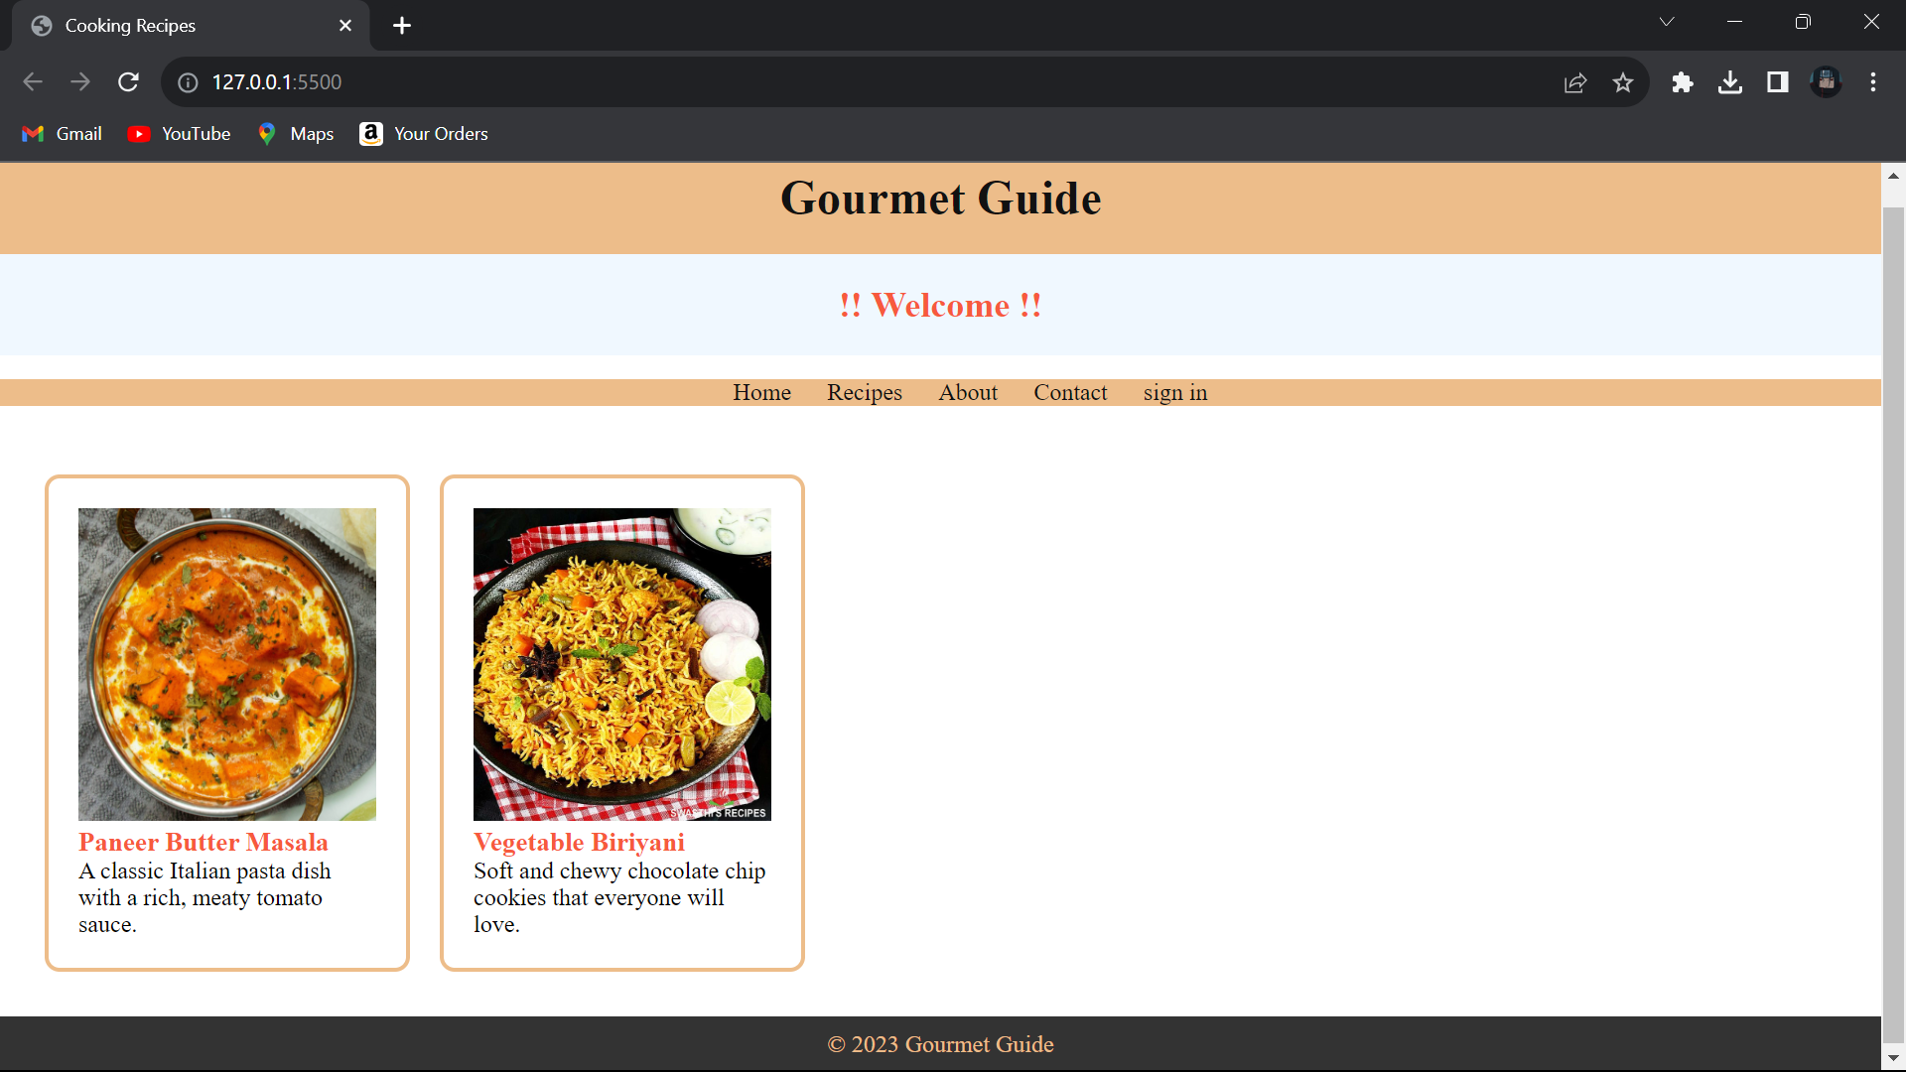

Slide 3
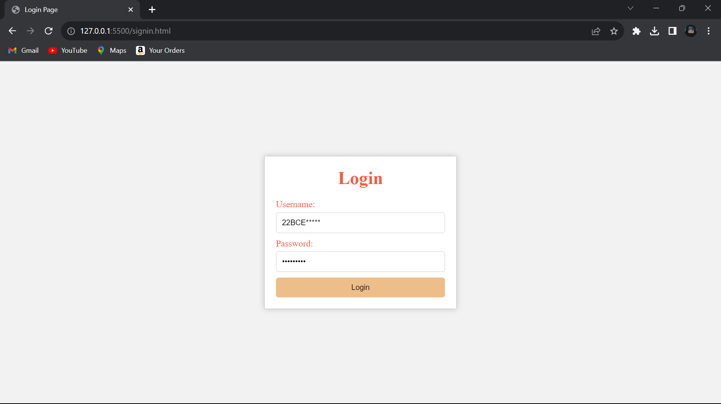

Slide 4
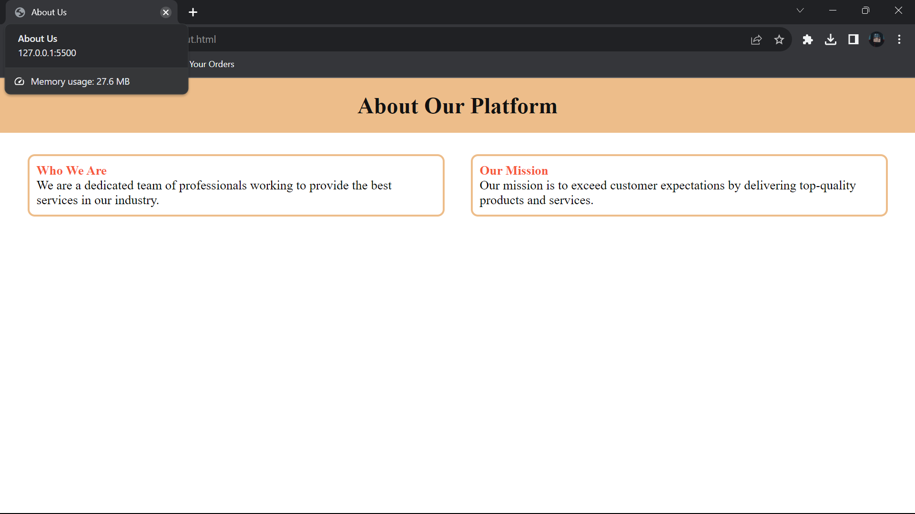

Slide 5
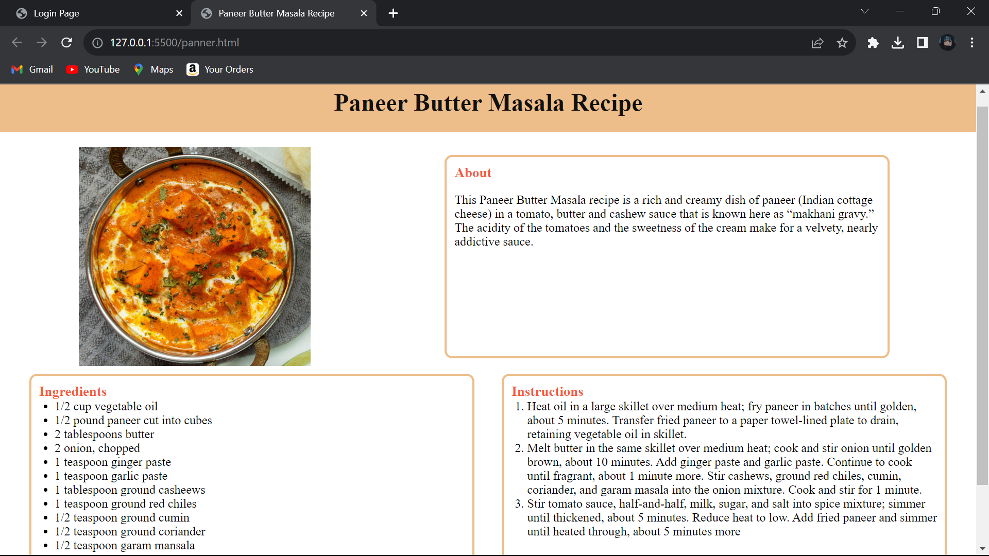

Slide 6
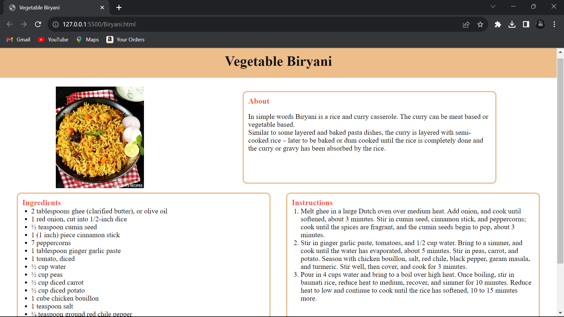

Slide 7
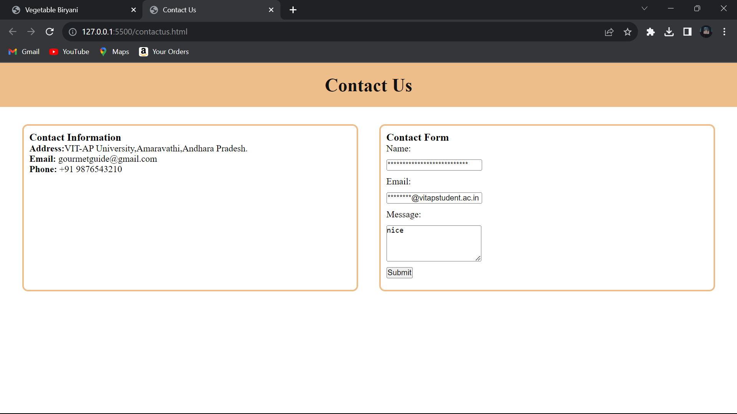

Slide 8
THANK YOU
GOLDEN DAWN - TEAM 14
D V SHANMUKHA KUMAR
A PARDHIV
P YATINDRA SATHVIK

